Slide 1
Recitation 1

Slide 2
Recitation Schedule
Introduction
Quick review on propositions, conjunctions, disjunctions, not, conditionals, biconditionals, converse, inverse, contrapositive
Practice problems

Slide 3
About
Undergraduate sophomore graduating in 2021
Computer Science and Cognitive Science major (CS²) with a mathematics minor
Software Development Engineer Intern at Amazon over the summer
Computer Vision Research Intern at Colgate-Palmolive
Undergraduate Research Assistant at SEQAM Lab
HackRU Organizer
Check out my medium publication: https://medium.com/phamiliarizing-myself-with-computer-science
Wrote about my Amazon internship experience: https://medium.com/phamiliarizing-myself-with-computer-science/inside-amazon-what-its-like-to-intern-at-a-top-tech-company-as-a-freshman-4d2bc2d66b14

Slide 4
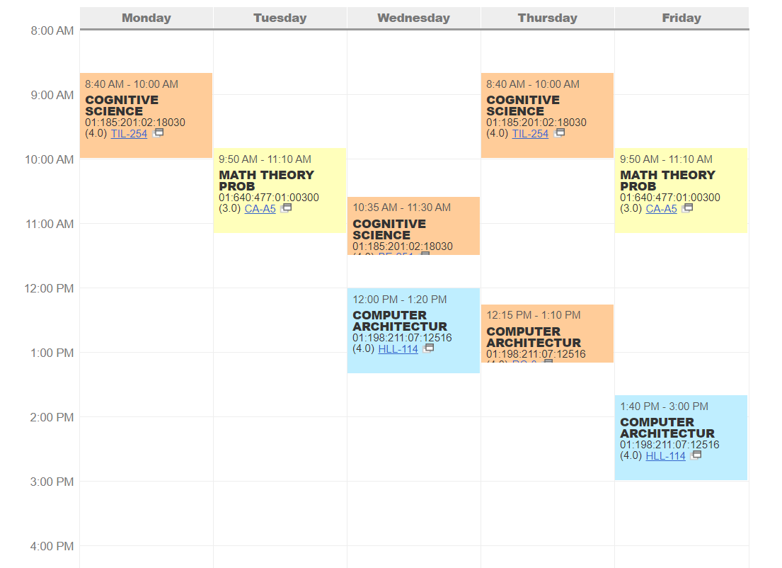

Slide 5
Contact
Email: isabella.pham@rutgers.edu
Office Hours: Wednesday 5PM-6PM RUTCOR111
Other:
Facebook: https://www.facebook.com/isabella.pham.96
LinkedIn: https://www.linkedin.com/in/isabella-pham-29312a162/
Discord: DeputyDank#1733
Github: Isabella-Pham
Notes:
RUTCOR is by Werblin

Slide 6

SKIPPING RECITATION: I get you want to but you can’t because we have quizzes during recitation and you have to turn your homework in too so don’t skip
Textbook PDF: https://t.ly/8q5M0

Slide 7
Propositions
Assign variables to propositions (claims). They can either be True (T) or False (F)
p = “Isabella is good at Fortnite”

Slide 8
Compound Propositions
Combining propositions together. Below are the different symbols used to create compound propositions:
and: ∧
nand: ⊼
or: ∨
nor: ⊽
xor: ⊕
not: ¬
conditional: →
biconditional: ↔
Notes:
Nand, nor, and xor aren’t commonly

Slide 9
Conjunctions
How do we represent a statement like this?
“Isabella is good at Fortnite and bad at League of Legends”
Let
p = “Isabella is good at Fortnite”
q = “Isabella is bad at League of Legends”
So we can write the above statement as “p and q” or “p ∧ q”
∧ is the symbol to represent “and” when working with propositional variables

Slide 10
Conjunction Truth Table
“Isabella is good at Fortnite and bad at League of Legends”
p = Isabella is good at Fortnite
q = Isabella is bad at League of Legends
p | q | p ∧ q
T T F F | T F T F
T
F
F
F

Slide 11
Disjunctions
How do we represent a statement like this?
“Isabella wants hotpot or Korean barbeque”
Let,
p = “Isabella wants hotpot”
q = “Isabella wants Korean barbeque”
So we can write the above statement as “p or q” or “p ∨ q”
∨ is the symbol to represent “or” when working with propositional variables

Slide 12
Disjunction Truth Table
“Isabella wants hotpot or Korean barbeque”
p = Isabella wants hotpot
q = Isabella wants Korean barbeque
p | q | p ∨ q
T T F F | T F T F
T
T
T
F

Slide 13
Conditional, Biconditional
Conditionals are “if...then” statements (though they don’t always have the words “if…then”
e.g. “I only eat hotpot when it is cold”.
Can be rewritten as “If I eat hotpot, then it is cold.”
Conditional: p → q, can also be written as ¬p ∨ q
Biconditional: p ↔ q, can also be written as (p → q) ∧ (q → p)
FUN QUESTION: What’s the opposite of a biconditional?

Slide 14
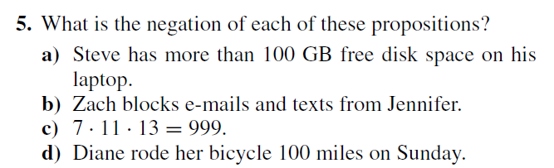
1.1 #5

Slide 15
Answers
Steve does not have more than 100 GB of free space on his laptop.
Zach does not block emails and texts from Jennifer
7*11*13 =/= 999
Diane did not ride her bicycle 100 miles on Sunday

Slide 16
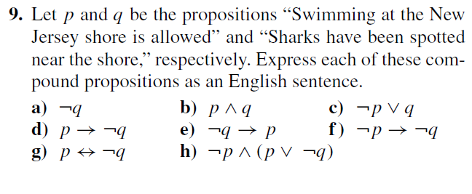
1.1 #9 a-c

Slide 17
Answers
Sharks have not been spotted near the shore
Swimming at the New Jersey shore is allowed and sharks have been spotted near the shore.
Swimming at the New Jersey shore is not allowed or sharks have been spotted near the shore.

Slide 18
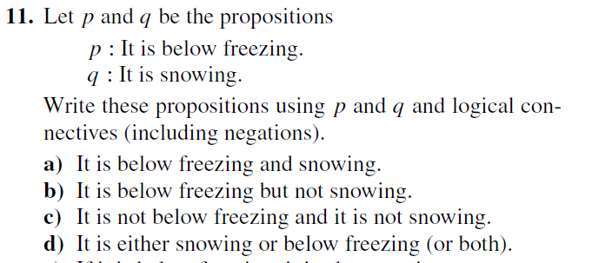
1.1 #11 a-d

Slide 19
Answers
p ∧ q
p ∧ ¬q
¬p ∧ ¬q
p ∨ q

Slide 20
Converse, Inverse, Contrapositive
Converse, inverse, contrapositive are different ways to transform the original conditional statement
Original: p → q
Converse: q → p
Inverse: ¬p → ¬q
Contrapositive: ¬q → ¬p
ONLY CONTRAPOSITIVE HAS SAME MEANING HAS THE ORIGINAL STATEMENT

Slide 21
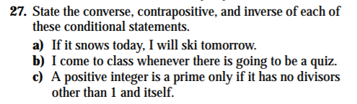
1.1 #27

Slide 22
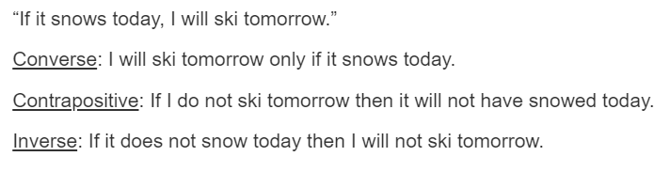
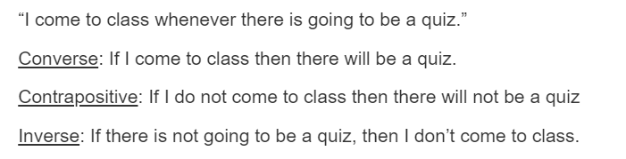
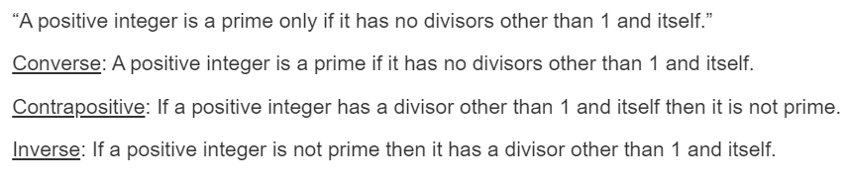
Answers

Slide 23
Bits
Series of 0s and 1s
e.g. 0010010
Think of the 0s representing “false” and the 1s representing “true”

Slide 24
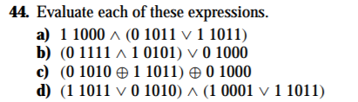
1.1 #44

Slide 25
Answers
1 1000
0 1101
1 1001
1 1011

